Slide 1

CSE- 4105
Lecturer-05
Mid-Point Circle Algorithm

Slide 2
Circle Generating Algorithms
Circles and ellipses are common components in many pictures.
Circle generation routines are often included in packages.
Notes:
‹#›

Slide 3
Circle Equations
Polar form
x = rCosθ
y = rSinθ (r = radius of circle)
y
P=(rCosθ, rSinθ)
r
rSinθ)
θ
x
rCosθ)
Notes:
‹#›

Slide 4
Drawing a circle
Disadvantages
To find a complete circle θ varies from 0° to 360°
The calculation of trigonometric functions is very slow.
θ = 0°
while (θ < 360°)
x = rCosθ
y = rSinθ
setPixel(x,y)
θ = θ + 1°
end while
Notes:
‹#›

Slide 5
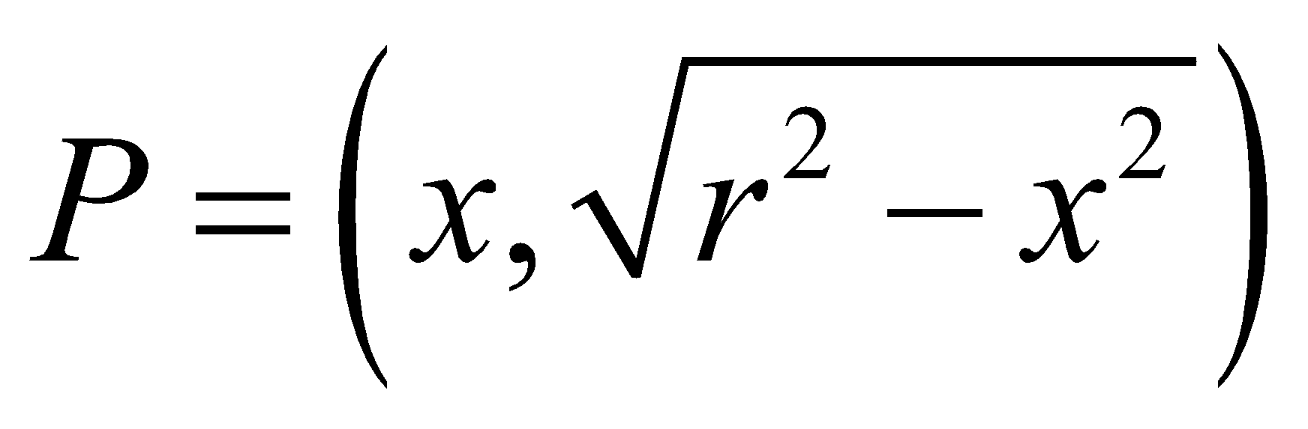
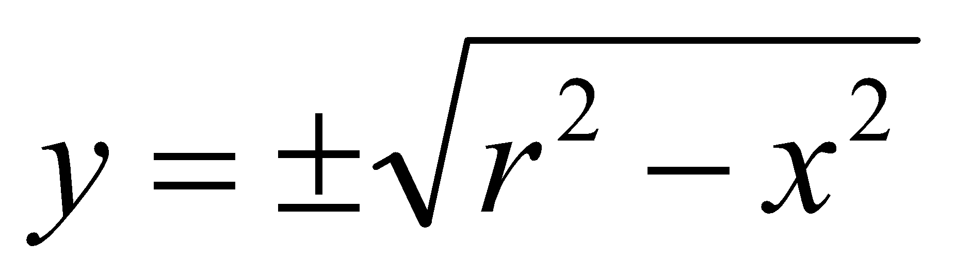
Cartesian form
Use Pythagoras theorem
x² + y² = r²
So, we can write a simple circle drawing algorithm by solving the equation for y at unit x intervals using:
r
y
x
y
r
y
x
x
Notes:
‹#›

Slide 6
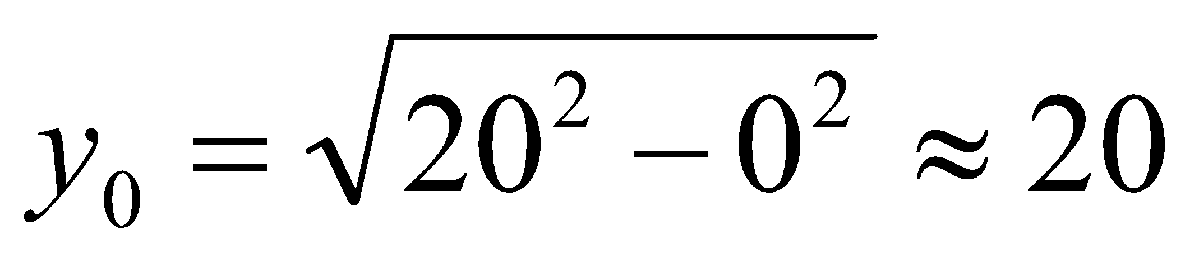
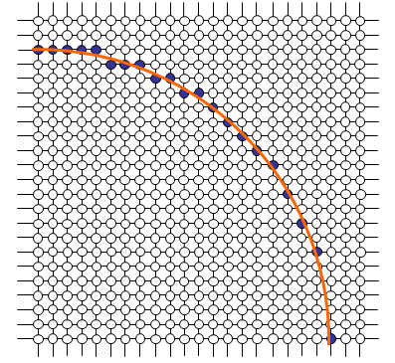
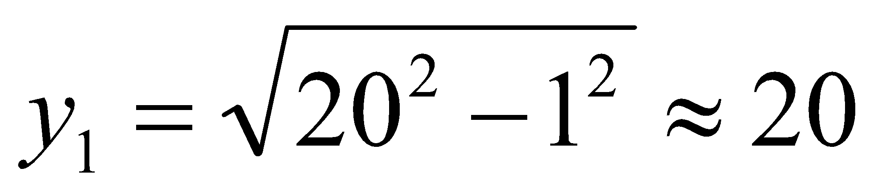
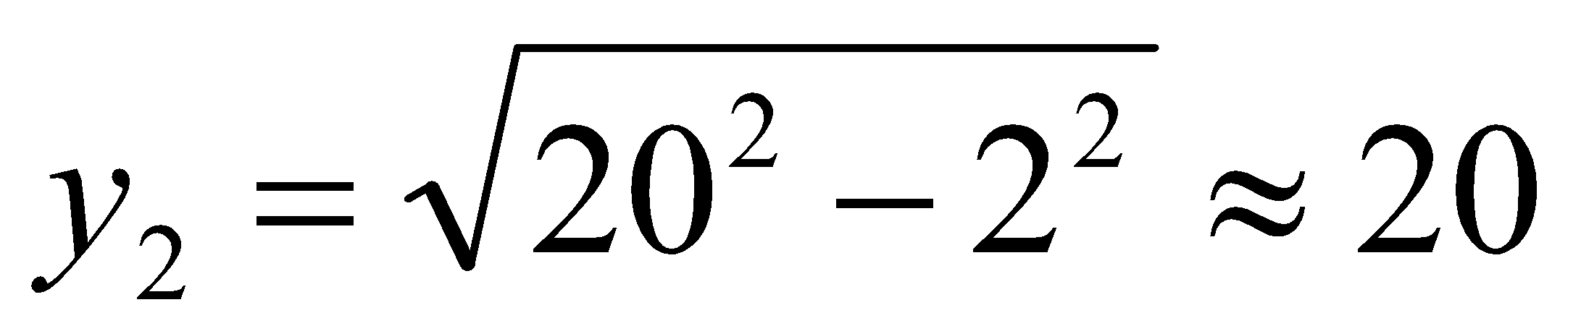
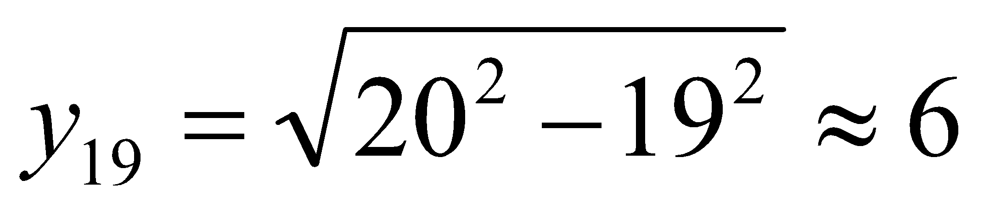
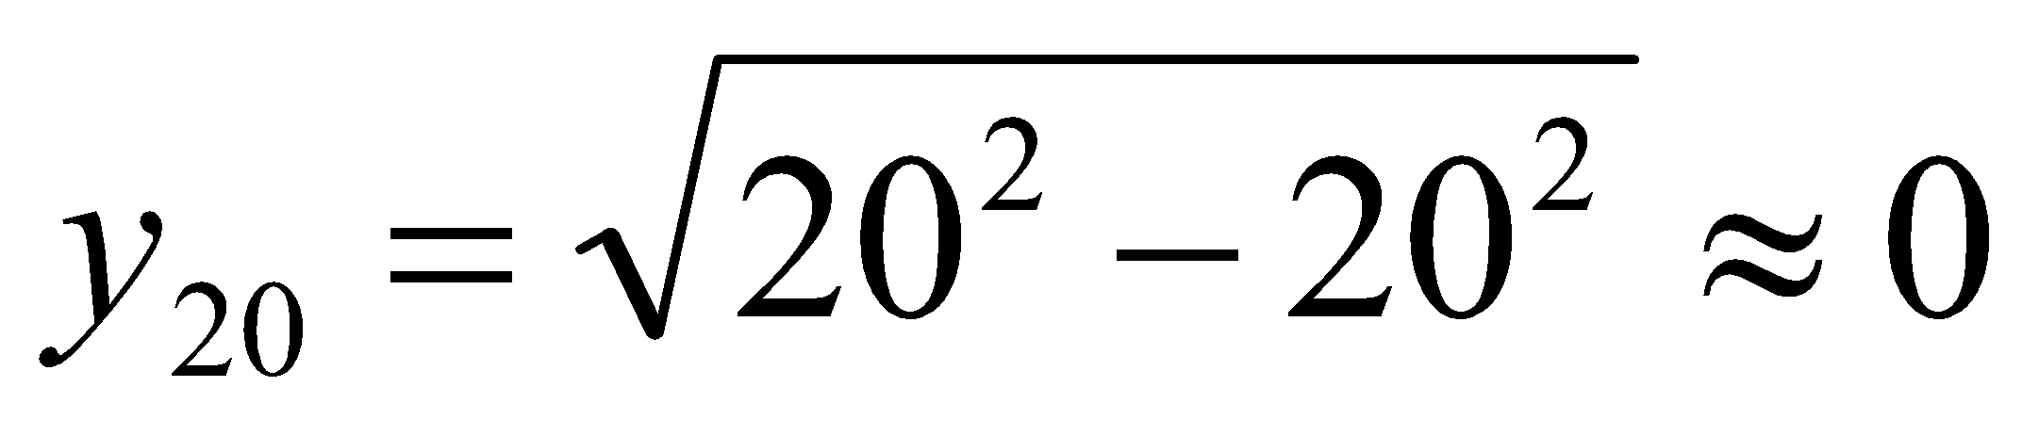
A Simple Circle Drawing Algorithm

Slide 7
Circle algorithms
Step through x-axis to determine y-values
Notes:
‹#›

Slide 8
Problems
However, unsurprisingly this is not a brilliant solution!
Firstly, the resulting circle has large gaps where the slope approaches the vertical
Secondly, the calculations are not very efficient
The square (multiply) operations
The square root operation – try really hard to avoid these!
We need a more efficient, more accurate solution

Slide 9
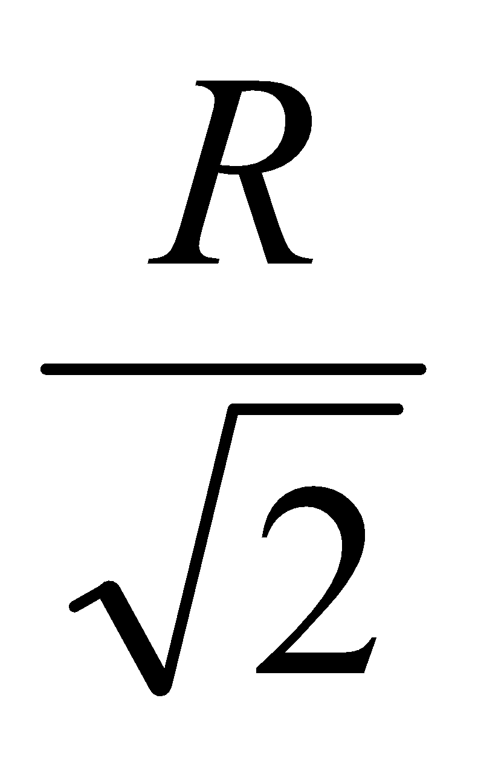
Circle Algorithms
Use 8-fold symmetry and only compute pixel positions for the 45° sector.
The first thing we can notice to make our circle drawing algorithm more efficient is that circles centred at (0, 0) have eight-way symmetry
(-x, y)
(x, y)
(-y, x)
(y, x)
(-y, -x)
(y, -x)
(-x, -y)
(x, -y)
Notes:
‹#›

Slide 10
Mid-Point Circle Algorithm
Similarly to the case with lines, there is an incremental algorithm for drawing circles – the mid-point circle algorithm
In the mid-point circle algorithm we use eight-way symmetry
so only ever calculate the points for the top right eighth of a circle, and then use symmetry to get the rest of the points

Slide 11
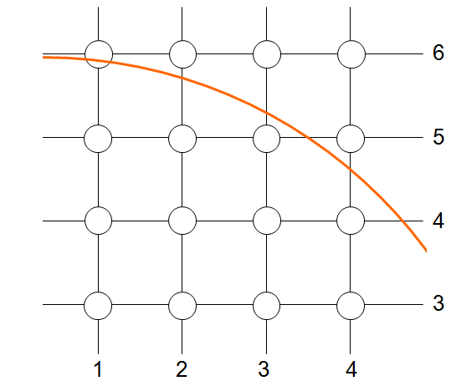
Mid-Point Circle Algorithm

Slide 12
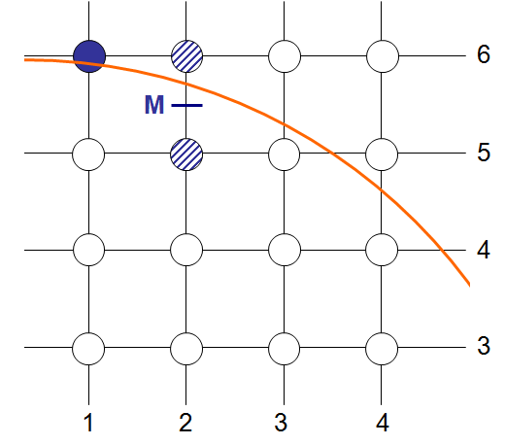
Mid-Point Circle Algorithm

Slide 13
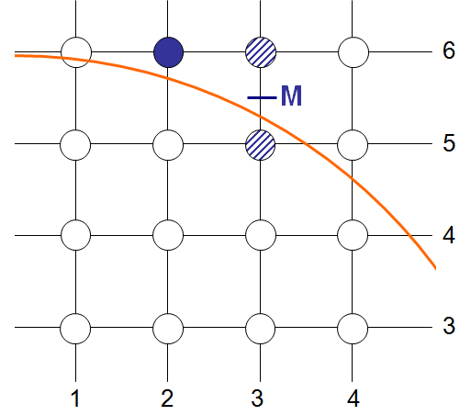
Mid-Point Circle Algorithm

Slide 14
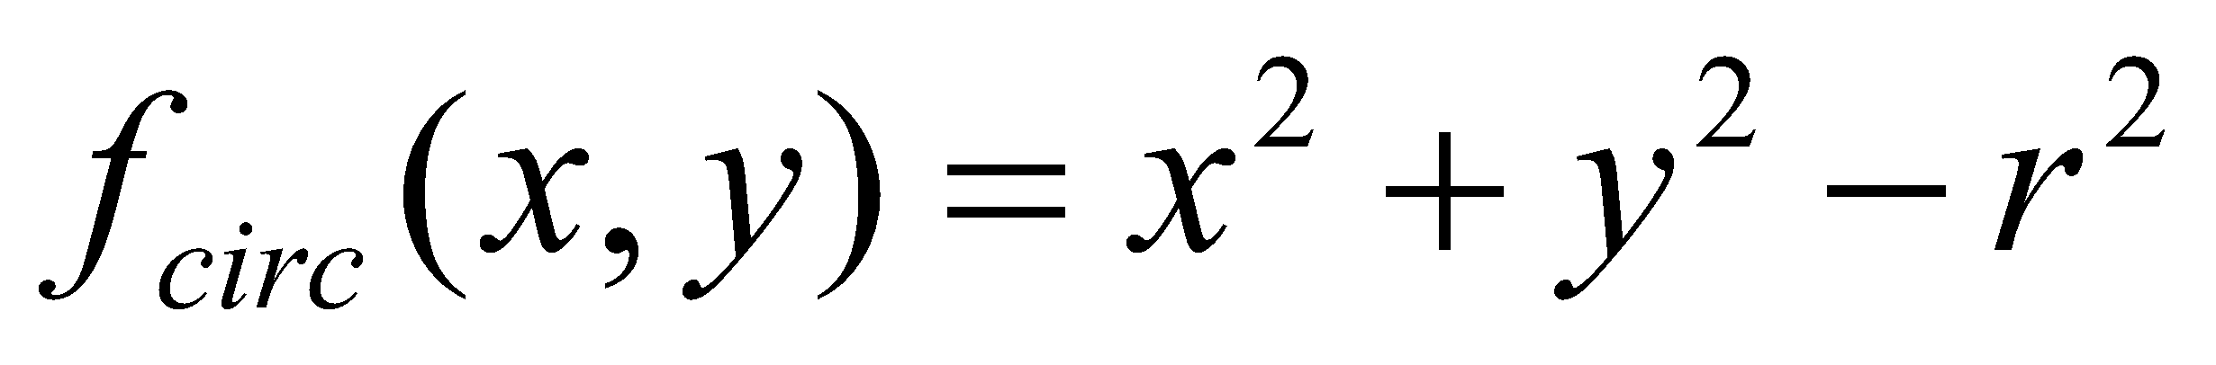
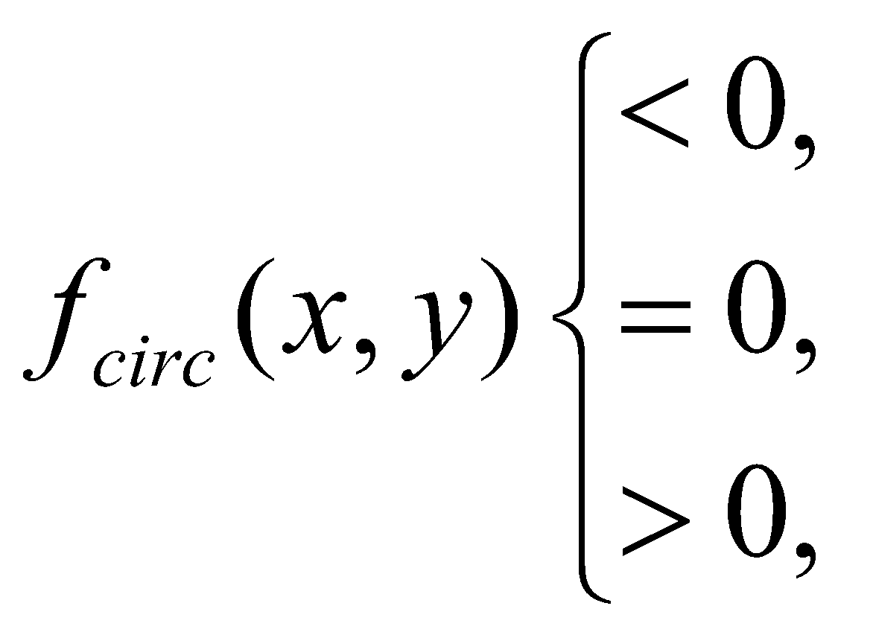
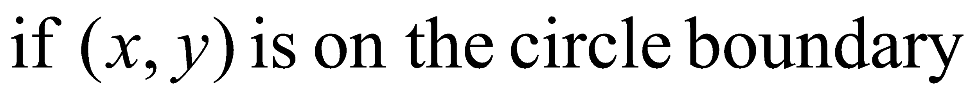
Mid-Point Circle Algorithm
Let’s re-jig the equation of the circle slightly to give us:
The equation evaluates as follows:
By evaluating this function at the midpoint between the candidate pixels we can make our decision

Slide 15
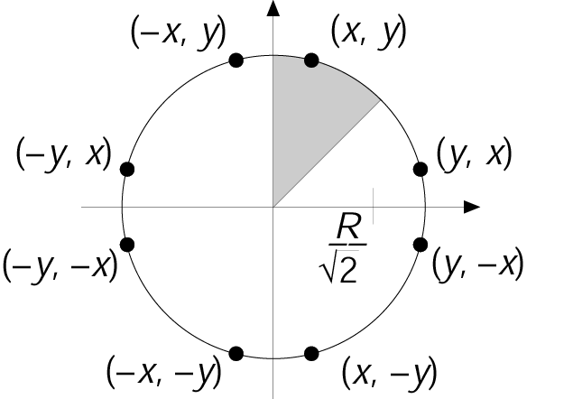
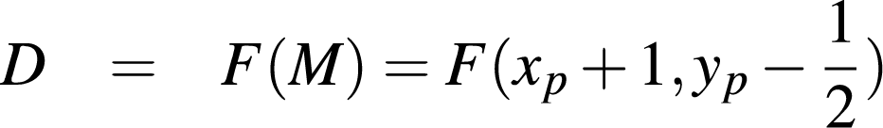
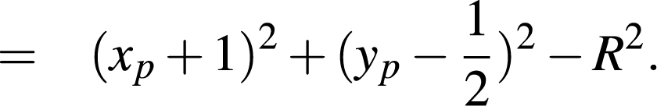


Scan Conversion of Circles
Mid-Point Circle Algorithm
We need a decision variable D:
If then M is below the arc, hence the E pixel is closer to the line.
If then M is above the arc, hence the SE pixel is closer to the line.
1994 Foley/VanDam/Finer/Huges/Phillips ICG
Notes:
‹#›

Slide 16
Mid-Point Circle Algorithm
y_{k}
y_{k}
midpoint
midpoint
y_{k}-1
y_{k}-1
F_{k} < 0
F_{k} >= 0
y_{k+1} = y_{k}
y_{k+1} = y_{k} - 1
Next pixel = (x_{k}+1, y_{k})
Next pixel = (x_{k}+1, y_{k}-1)
‹#›

Slide 17

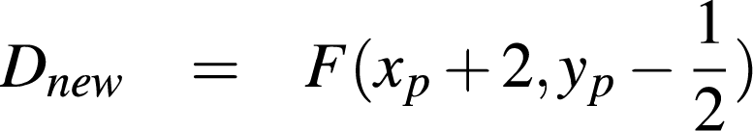
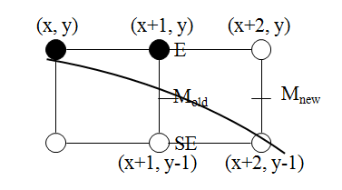
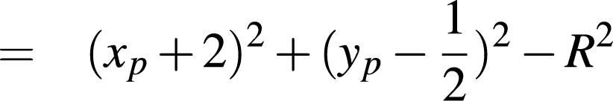
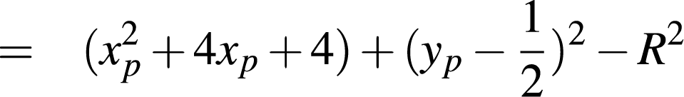
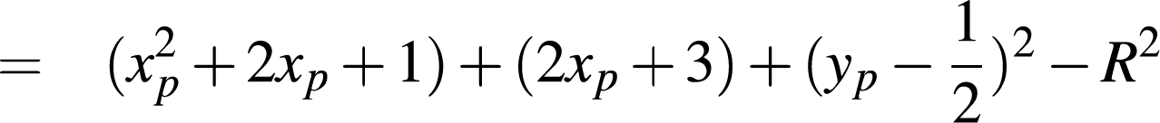
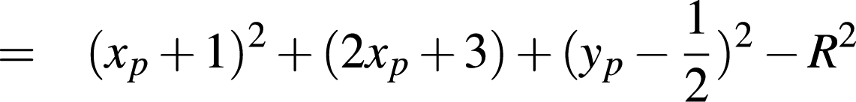


Case I: When E is next
Mid-Point Circle Algorithm
What increment for computing a new D?
Next midpoint is:
Hence, increment by:
Pics/Math courtesy of Dave Mount @ UMD-CP
Notes:
‹#›

Slide 18
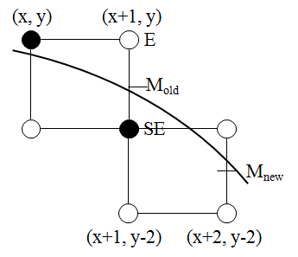

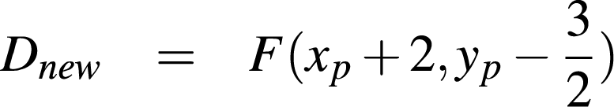
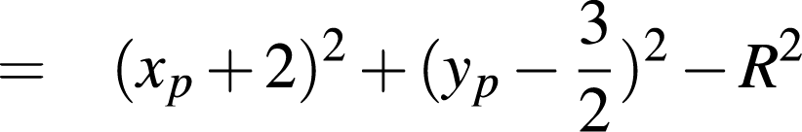
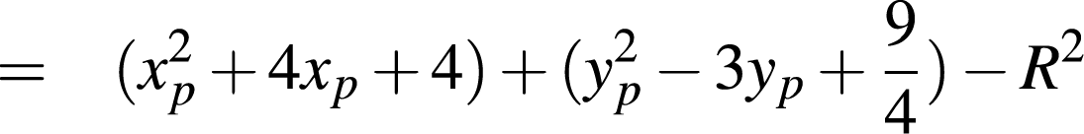


Case II: When SE is next
What increment for computing a new D?
Next midpoint is:
Hence, increment by:
Notes:
‹#›

Slide 19
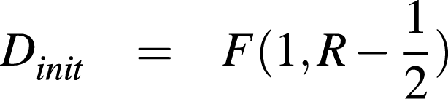
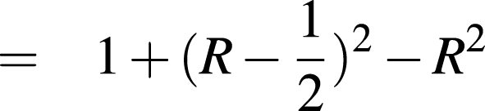
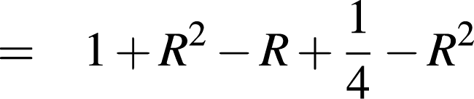
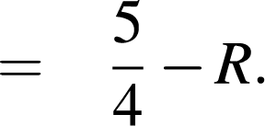
Scan Conversion of Circles
How to compute the initial value of D:
We start with x = 0 and y = R, so the first midpoint is at x = 1, y = R-1/2:
(0,-R)
(R,0)
(0,R)
Notes:
‹#›

Slide 20
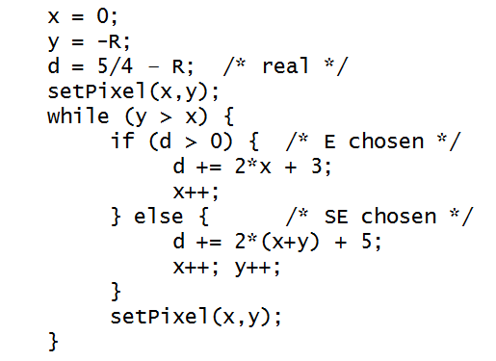
Algorithm

Slide 21
Thank You

